Slide 1

ABOUT PROJECT
Vending Machine Application
In this presentation, we will discuss the design and implementation of an application that simulates an automatic vending machine.
Vending Machine Abstract Class
The class VendingMachine provides an interface and defines abstract methods for operations such as product selection, dispensing, and price retrieval.

Slide 2
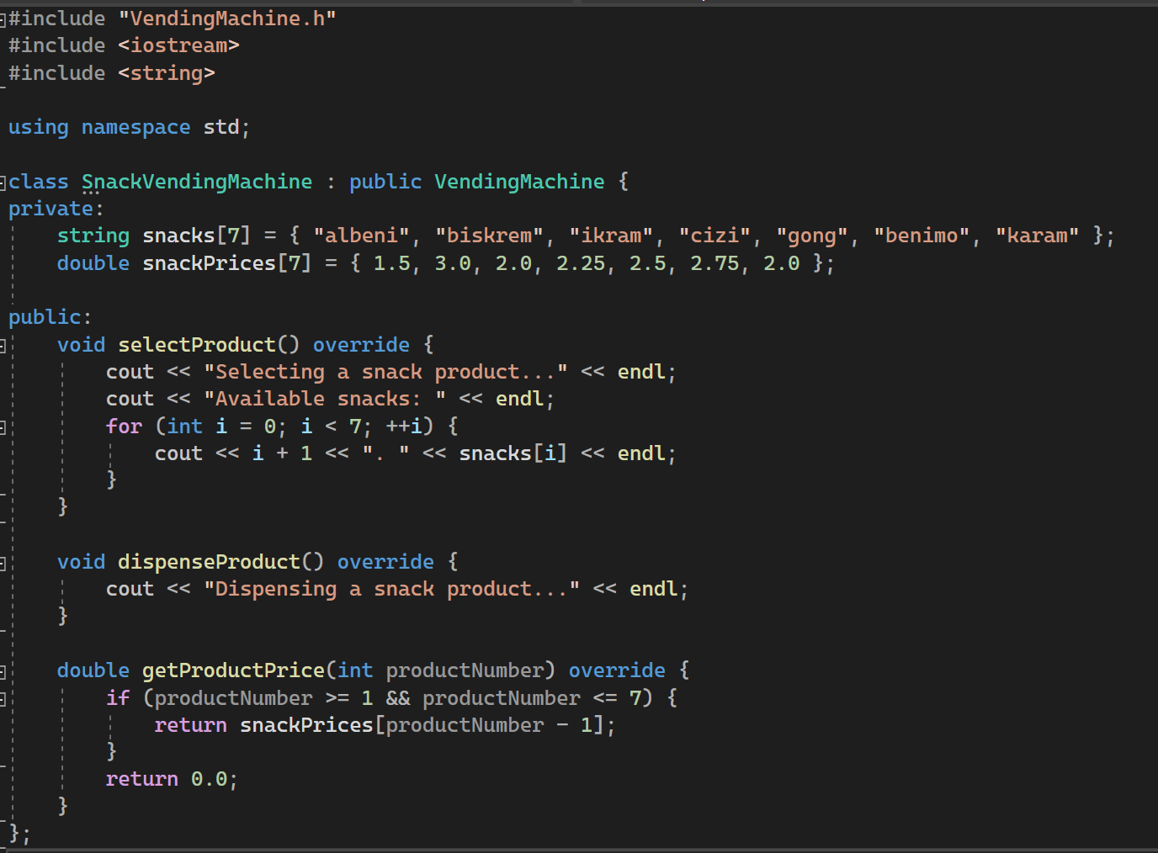
SnackVendingMachine Class
The class SnackVendingMachine inherits from the VendingMachine class and creates a specialized vending machine for snack products. The snack list and prices are defined within this class.
SnackVendingMachine Methods
The class SnackVendingMachine includes methods that implement product selection, dispensing, and price retrieval. It displays the available snack products to the user and calculates the price of the selected item.

Slide 3
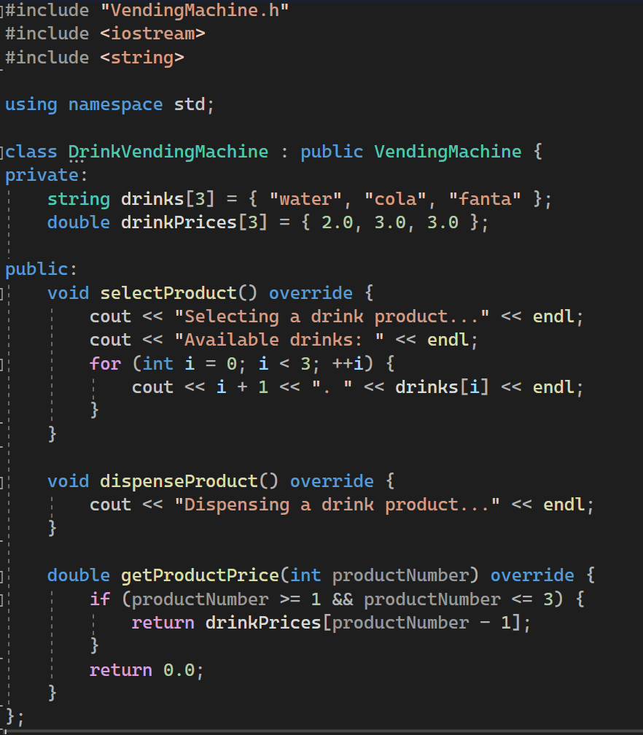
DrinkVendingMachine Class
The class DrinkVendingMachine inherits from the VendingMachine class and creates a specialized vending machine for beverages. The drink list and prices are defined within this class.
DrinkVendingMachine Methods
The class DrinkVendingMachine includes methods that implement product selection, dispensing, and price retrieval. It displays the available drink options to the user and calculates the price of the selected item.

Slide 4
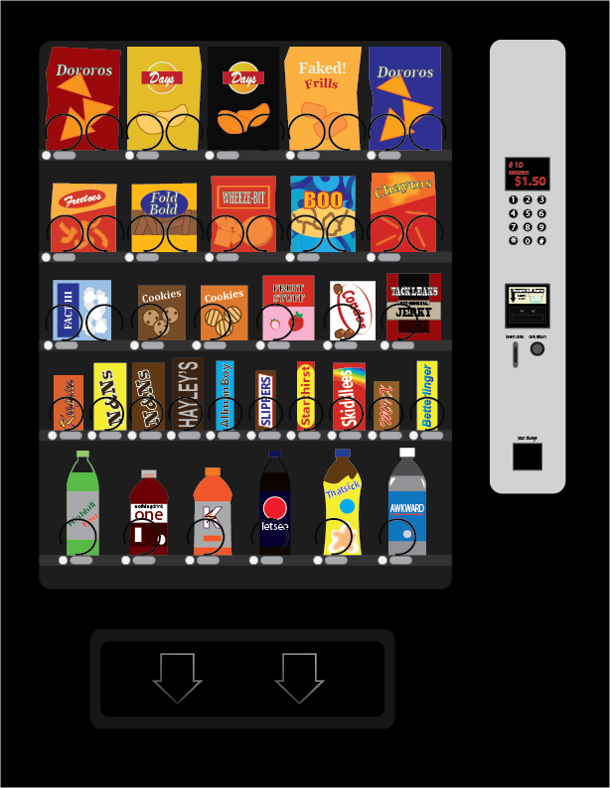
Main Function
The main function provides an interactive Vending Machine experience for the user. The user selects the type, enters the product number, makes a payment, and can repeat the process.

Slide 5

UML DIAGRAM
+ selectProduct () : void……………………………..
+ dispenseProduct () : void………………………….
+ getProductPrice (productNumber : int) : double
VendingMachine
inherits
inherits
SnackVendingMachine
DrinkVendingMachine
-snacks : string [7]
-snackPrices : double [7]
---------------------------------------------------------------------
+selectProduct () : void
+dispenseProduct () : void
+getProductPrice (productNumber : int) : double
-drinks : string [3]
-drinkPrices : double [3]
---------------------------------------------------------------------
+selectProduct () : void
+dispenseProduct () : void
+getProductPrice (productNumber : int) : double

Slide 6
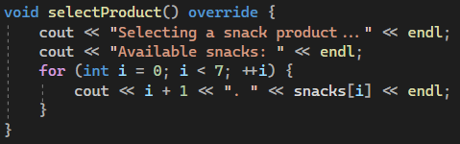

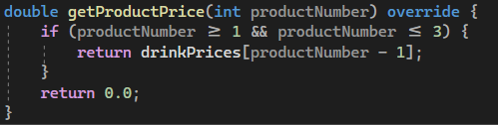
OVERRIDE EXPLANATION
The "override" keyword is used in certain methods of the "SnackVendingMachine" and "DrinkVendingMachine" classes. These methods redefine the abstract methods inherited from the "VendingMachine" class.
The "selectProduct()" method overrides the abstract method in the "VendingMachine" class. This method performs the process of selecting a snack or drink and displays the available products to the user.
The "dispenseProduct()" method overrides the abstract method in the "VendingMachine" class. This method carries out the process of dispensing the product.
The "getProductPrice(int productNumber)" method overrides the abstract method in the "VendingMachine" class. This method returns the price of a specific product.

Slide 7
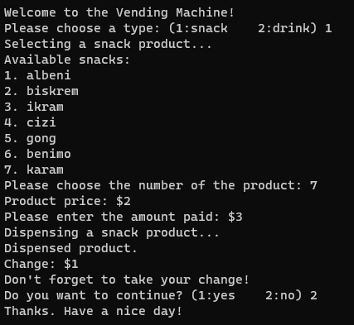
Screen Output Examples
First of all, the user comes across two options as snacks and drinks and is asked to choose one of them.
Products are listed after selection is made.
A product is selected from the list and the price of the selected product is displayed.
If more money is entered than the product price, it calculates the change and gives it with the product.

Slide 8
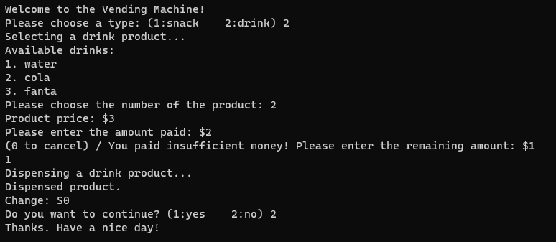
If the money entered is less than the price of the product, it will be requested to add money again or the option to cancel the order is given.

